Slide 1

Welcome Microsoft Business Applications
F&O Lecture 2: Explore the technical architecture of finance and operations apps
Build finance and operations apps
Notes:
Welcome and Thank you for joining us today
Before we start some house keeping and basic check
Can you all hear me clearly and see my screen ?
Please stay mute if you are not speaking.
We will make the session as much as interactive but in case you have a question, please hold it until we get into Q&A session or drop the question in the chat so that one of moderator can response in the meantime.
Use the hand raise functionality if you want to speak up
I will keep it to basic to ensure everyone gets on the same page as we go along through the training sessions.

Slide 2
Explore the technical architecture of finance and operations apps
Build finance and operations apps
Extend finance and operations apps

Slide 3
Explore the technical architecture of finance and operations apps
Introduction
To develop for finance and operations, you need to understand packages, models, elements, metadata management, source control, and Lifecycle Services.
Differentiate cloud and on-premises architecture
Understanding the underlying architecture of finance and operations will help you appreciate the rich functionality of the user interface, regardless of deployment type.
Finance and operations apps cloud deployment
Cloud deployments for finance and operations offer reduced implementation time, lower costs, and easier scalability.
Finance + Operations (on-premises) deployment
The deployment type should be chosen based on the organization's needs and preferences.

Slide 4
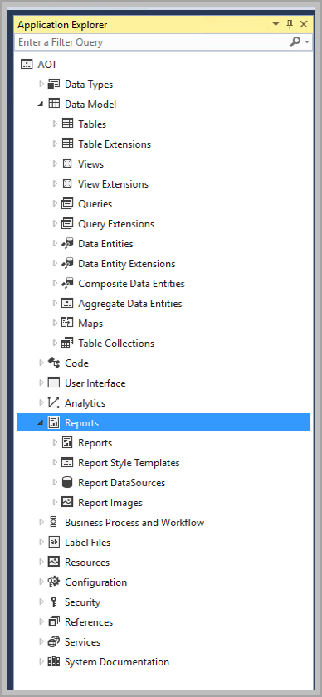
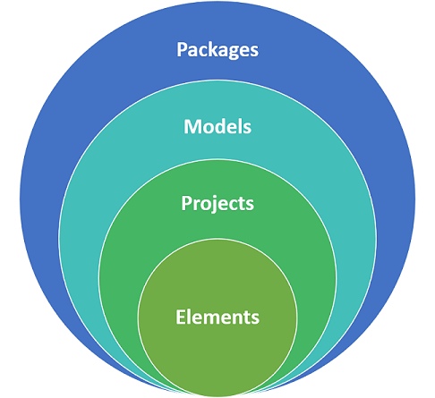
Elements, models, and packages
Application Object Tree (AOT)
Elements, models, and packages represent the structural hierarchy in Visual Studio for finance and operations. Elements either exist out of the box in the application explorer (AOT) in Visual Studio, or they can be created. Elements are metadata and source files, such as base enumerations and tables.

Slide 5
Create a new model
To create a new model, follow these steps
From the Dynamics 365 menu in Visual Studio, select Model Management > Create model to open the Create model wizard.
Enter the Model name, Model publisher, layer, Model description, and Model display name.
Select Next.
Select Create new package. This will create a model that builds into its own assembly. This should be used to store elements that extend the application.
Select Next.
Select the referenced models. Reference models provide access to all the elements that are located inside of the other models. The Application Suite, Application Platform and Application Foundation will give you access to most of the elements.
Select Next.
On the Summary step, verify that the information is correct.
Optionally, select Create new project to create a project when the model is created.
Optionally, select Make this my default model for new projects.
Select Finish.

Slide 6
Build models
Before you create a deployable package, you should perform a model build. You may also need to perform a model to resolve errors you might be getting while working on a development project. To build models, follow these steps.
From the Dynamics 365 menu in Visual Studio, select Build models.
In the Packages list, select the packages that you want to build. The models that are related to the packages are listed in brackets.
Optionally, you can select Build referenced packages to build dependent packages first.
On the Options tab, you can select from multiple build processes. These processes increase the build time, so if you do not need to run the process, leave the following options cleared.
Build Pre-Compiled Forms - Static HTML is generated for each form during the build to allow faster rendering of forms at runtime.
Build reports - Builds reports.
Build Aggregate Measurements - Builds aggregate measurements.
Run Best Practice Checks - Best practice checks are performed during the build.
Synchronize database - Updates the SQL database schema during the build.
Build cross reference data - Data for the cross-reference feature is updated to allow developers to find references to code and metadata.
Select Build.
Expand the Details tab to see the build process details.

Slide 7
Application components and architecture
Application-specific models
Platform models
Runtime and Data access
Workflow and services
Client and Presentation
Application foundation
SSRS reporting
Test essentials
Application suite
Application suite sits on top of Application foundation, and it contains application-specific elements. The Application suite model contains components of Supply Chain Management.
Other models
Other models, such as Currency, Directory, Contacts, and more, cover individual functionalities that are available in the application stack.
Dynamics 365 product suite
Dynamics 365 is a business application that consists of several solutions, such as Sales, Marketing, Service, Finance, Commerce, and Supply Chain Management. The latter three are considered the finance and operations apps.

Slide 8
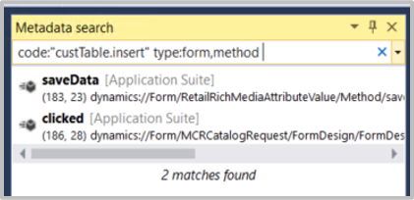
Metadata management processes
Finance and operations uses metadata to define elements.
Keywords that you can use in the Metadata search include:
Name - Filter by element name. This is also the default filter if no keyword is specified. A comma can be used to search for multiple element names.
Type - Filter by element type. A comma can be used after an element to specify sub elements.
Model - Filter by model name. Each comma-separated value will look for a model in your application.
Property - Filters properties on forms. Each comma-separated value should be a property on the form.
Code - Filter code snippets. The code snippet should be in quotes.

Slide 9
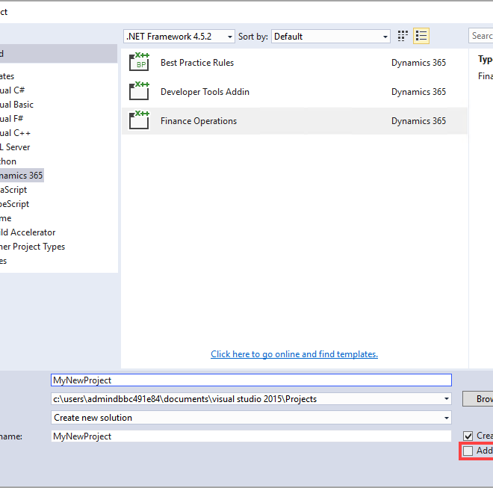
Source control processes
Developers rely on source control to track code changes and discover differences among content that is created by various developers.
Azure DevOps,
Formerly Visual Studio Team Services
Azure DevOps
Branching and merging

Slide 10
Conform code to organization policies
Developers should follow best practices to ensure that their code is high-quality and meets organizational policies.
Lifecycle Services (LCS) aids developers in managing the lifecycle of finance and operations implementations, offering tools for deploying and maintaining cloud-based or on-premises environments, including Cloud-hosted environments for Azure AD deployment of various types of environments.

Slide 11
Build finance and operations apps
Set up a VHD for finance and operations apps
Start developing for finance and operations apps by using Visual Studio
Get started with development using X++ in finance and operations apps
Develop object-oriented code in finance and operations apps
Implement application lifecycle management in finance and operations apps
Build extended data types and enumerations for finance and operations apps
Build tables in finance and operations apps
Build forms and optimize form performance in finance and operations apps
Create classes in finance and operations apps
Build reports for finance and operations apps
Build workspaces in finance and operations apps
Implement role-based security in finance and operations apps
Apply basic performance optimization in finance and operations apps

Slide 12
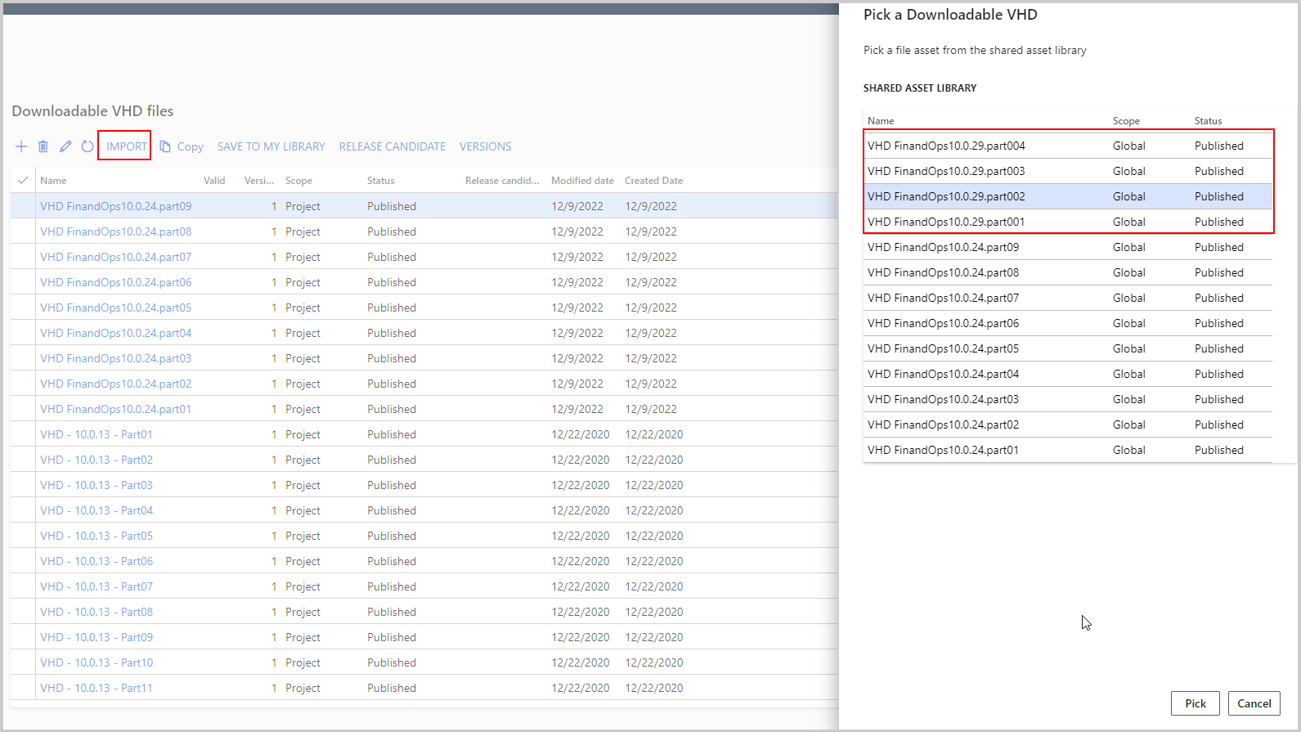
1.Set up a VHD for finance and operations apps
1.1 Introduction
A VHD can be used to develop and test finance and operations apps in a controlled environment.
1.2 Set up a VHD for first-time use
Your first step is to locate the files for the VHD, which you can access from the Asset library of Lifecycle Services. To find the Asset library, select the dropdown menu in the upper-left corner, as shown in the following screenshot.

Slide 13
1.3 Set up and manage a downloadable VHD for development
After you’ve downloaded the VHD files, double-click the part01 file because it contains the .exe file that will extract all compressed files (part02 – part09) and will create a single virtual hard disk (.vhd) file
Enable Hyper-V in Windows
To enable Hyper-V, open Turn Windows Features on or off and check the Hyper-V box.
Click to Learn :
Set up a new Hyper-V virtual machine
Set up Visual Studio, Microsoft SQL Server Management Studio, and more

Slide 14
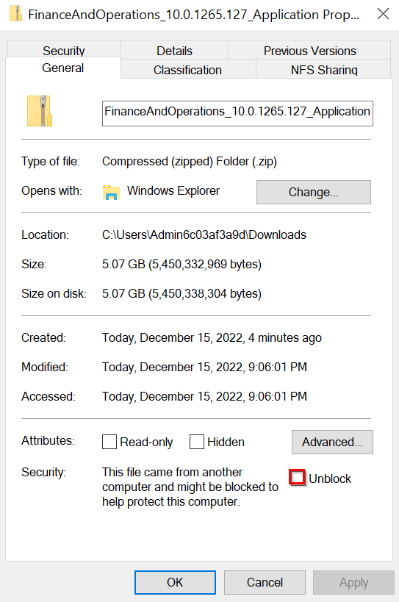
1.4 Upgrade the VHD
As you continue to work on the virtual hard disk (VHD) and use it in conjunction with your Lifecycle Services deployed environments, updates will occur and make the local VHD out of date in comparison.
When in the folder, run the following command:
AXUpdateInstaller.exe devinstall
Click to follow:
Exercise – Install a virtual machine

Slide 15
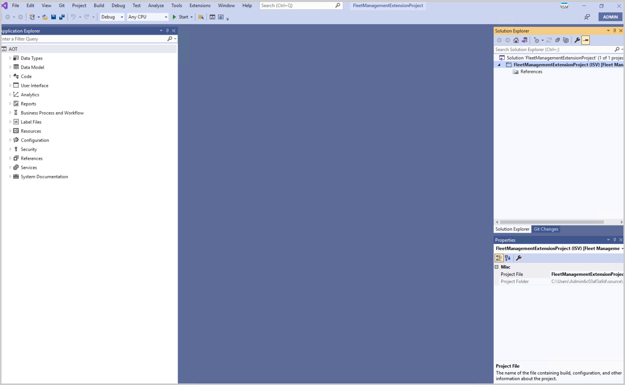
2. Start developing for finance and operations apps by using Visual Studio
Visual Studio is the integrated development environment (IDE) for finance and operations apps.
2.1 Introduction
While users are typically working in the user interface, developers work in Visual Studio in their own developer environment.

Slide 16
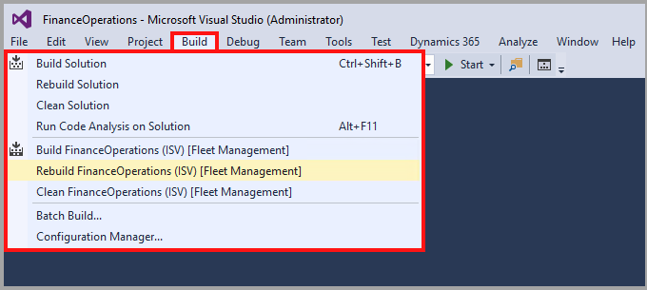
2.2 Create and build projects
Projects in Visual Studio contain elements, which are stored as metadata when they are built. The metadata is then used by the application to run your extensions.
You can build or rebuild your project or solution from the Solution Explorer window.
Click the link below:
Watch this video to see how you can create a new project.

Slide 17
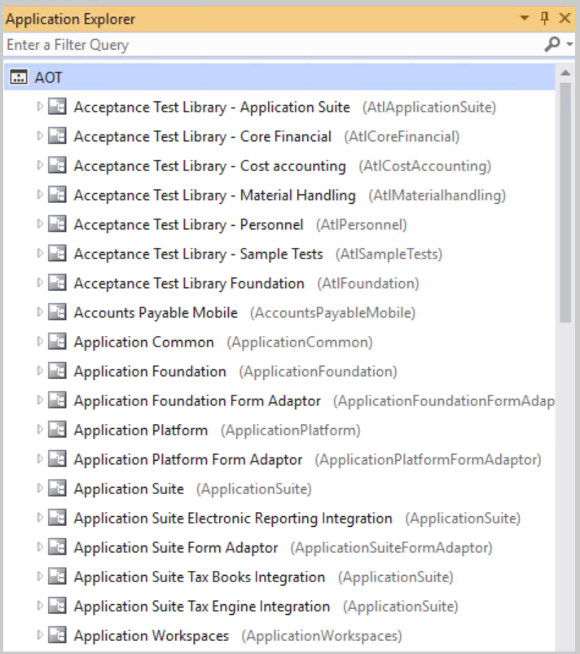
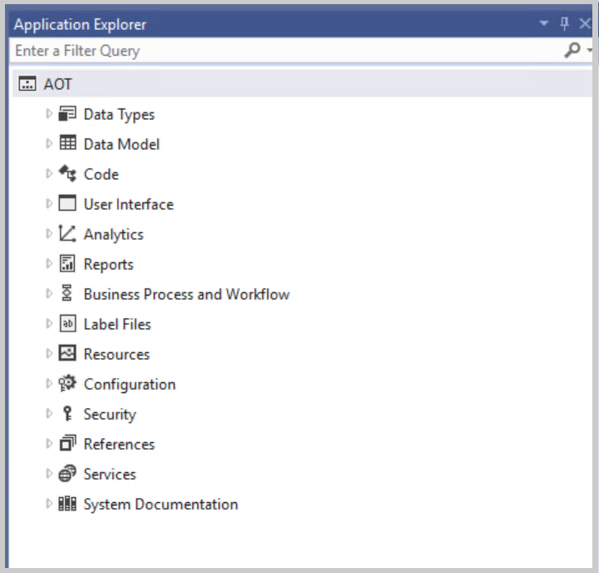
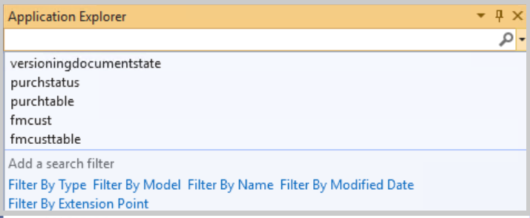
2.3 Manage metadata by using the Application Explorer
Metadata in existing models is available in the Application Explorer. The Application Explorer contains the Application Object Tree (AOT), which has two views: the model view and the classic view.
-Model view -Classic view
Metadata types:
Extended Data Types (EDTs)
Enums
Tables
Forms
Data entities
Search:

Slide 18
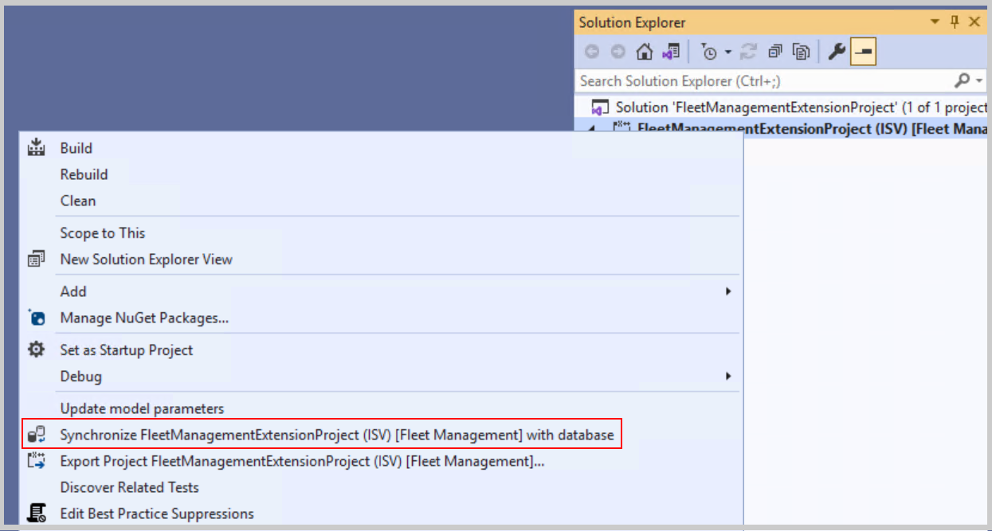
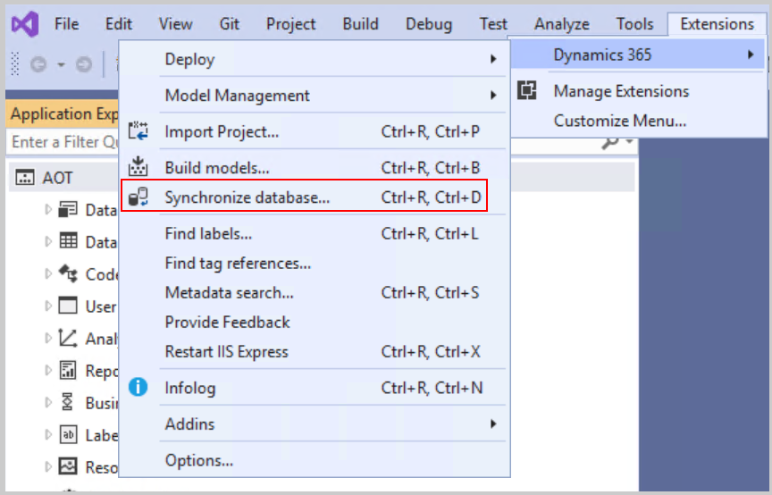
2.4 Build deployment packages
To apply your code changes to a non-development environment, build a Software Deployable Package (SDP) and upload it to Lifecycle Services.
Click the link below:
Watch the following video to learn about creating a deployable package.
2.5 Synchronize data changes with the database

Slide 19
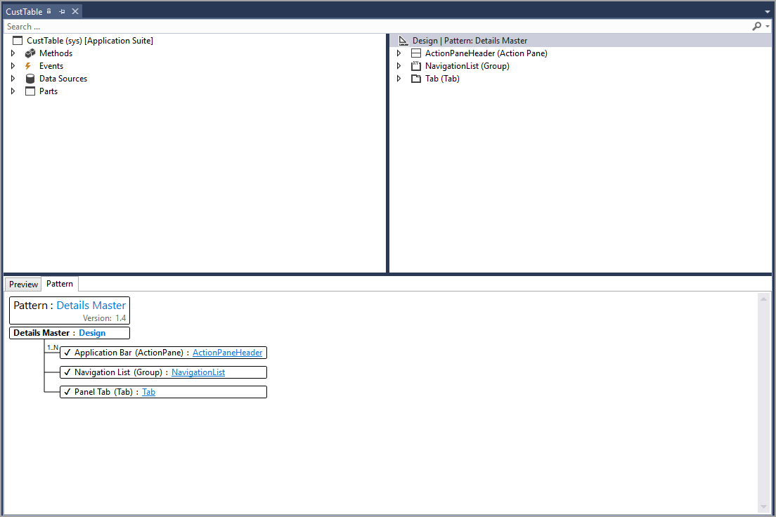
2.6 Use the Element Designer to create elements
Form Designer
Normal Element Designer
Pattern Designer
This populates the pattern's requirements in the Pattern Designer so that you know what you need to add to complete the form.

Slide 20
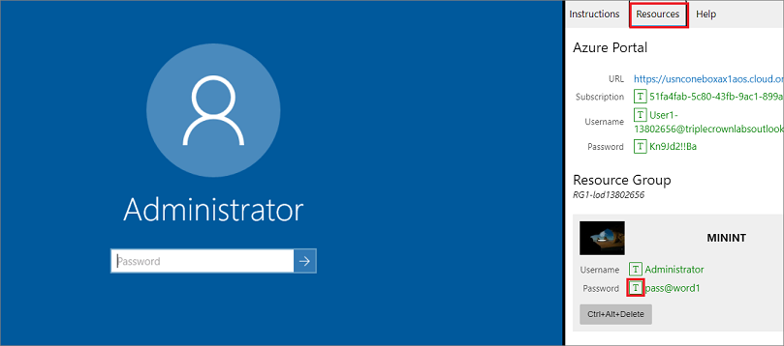
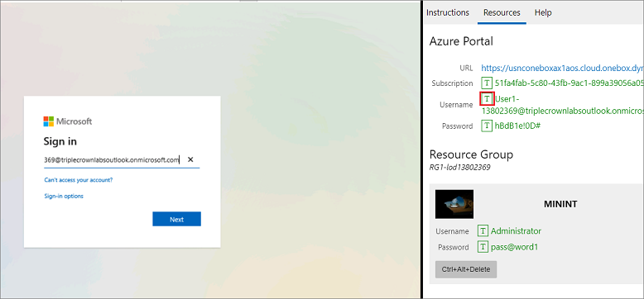
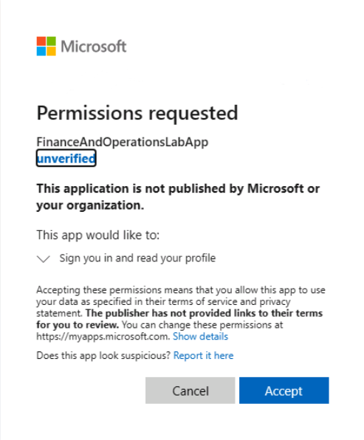
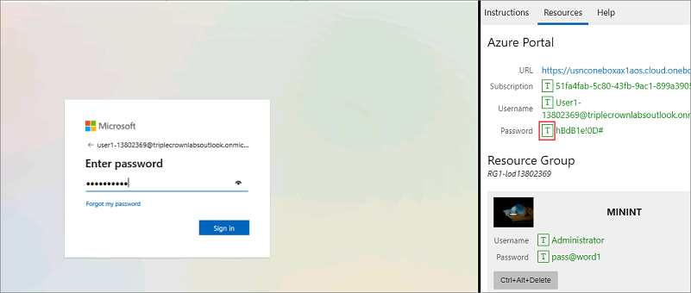
Lab - Create a project and add an element
Ensure that you are signed in to Microsoft Learn.
Select Launch VM mode or Sign in to launch VM mode in this unit.
In the Resources tab on the lab side bar, select the T icon next to Password in the MININT box, to have the administrator password for the Virtual Machine entered for you.

Slide 21
Scenario
The finance and operations apps developer is a new employee at the Fleet Management company. The developer needs to create their own project in Visual Studio to begin developing new elements. The developer has been tasked with creating a new Extended Data Type (EDT) for vehicle color.
Create a new project
Create a new vehicle color EDT
Close the lab environment

Slide 22
3. Get started with development using X++ in finance and operations apps
3.1 Introduction
X++ has a user-friendly memory management model that is identical to .NET. A few areas where X++ differs from other managed languages are:
Strong data access statements
Tight integration with system and user metadata
A strong extensibility story with Pre/Post event handlers and chain of command
Case insensitivity, meaning that "While," "while," and "WHILE" are the same (C# is case-sensitive)
3.2 Implement base types and operators
Data types
Composite data types
User-defined data types
Variables
Watch the following video to learn how to declare a variable.
Operators

Slide 23
3.3 Common structured programming constructs of X++
Private - Makes the variables only usable within the class that it is defined in.
Protected - Makes the variable only usable within the class that it is defined in and any subclass of that class.
Public - Makes the variable usable anywhere and is the default modifier.
Methods can be as follows:
Instance methods (or object methods) - Are embedded in the object that was created from a class. The object must be instantiated before you can use this method. An instance method can access the instance and static state, whereas a static method can only access the static state.
Static methods (also known as class methods) - You do not need to instantiate an object to use these methods.

Slide 24
3.4 Use X++ to write SQL statements
Select [FindOptions] [FieldList] from [Table] [Options] [OrderByClause] [WhereClause] [JoinClause]
crossCompany pulls data across legal entities, Fistcompany pulls only the first record,
firstonly10 only fetches the first ten records, forupdate selects the data with a lock, sum, avg, minof, maxof, count.
Insert methods can be used to add a new record to a table doInsert( ), insert_recordset
To update a record, you must use a select forupdate, update_recordset to update multiple records at the same time.
doDelete( ) method to override the standard delete method.
You can also delete multiple records at once with the delete_from statement.

Slide 25
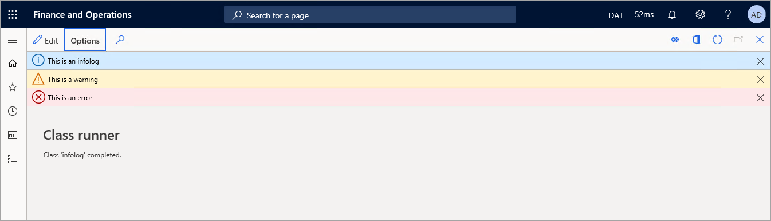
3.5 Use conditional and iterative statements
Conditional statements are used to determine if a block of code should be run.
If statement, If...else statement, Switch statement, Using iterative statements (while, do while, while).
Break statements :
Terminating loops
Separation of case statements in a switch statement
Click the link : Watch the following video to learn about conditional statements
3.6 Exception handling
While conditional statements are great for handling the running of different code blocks, exception handling is used to deal with errors. throw, try...catch, finally, retry.
User messages :
By using the Message() API, you can have more control over the lifecycle of a message, you can explicitly add and remove messages.
Exceptions inside transactions
ttscommit, ttsabort, ttsbegin

Slide 26
3.7 Use const values
Constant values can be used to define a variable and assign it a value that does not change.
const str constantVariable = "Value";
3.8 Use X++ runtime functions for common tasks
Business operations - Enter financial data and calculate financial formulas.
Container operations - Run functions to manipulate the container data type.
Conversions - Translate the data from one type to another data type.
Date operations - Manipulate the date data type.
Mathematical operations - Used to perform additional calculations.
Reflection operations - Access an object's metadata and return other metadata for the object.
Session operations - Change or report current user connection to finance and operations apps.
String operations - Like the date operations, string operations can manipulate the string data type.

Slide 27
3.9 Call .NET libraries by using X++ code
Finance and operations apps projects in Visual Studio contain X++ code that interacts smoothly with code that is written in other .NET languages.

Slide 28

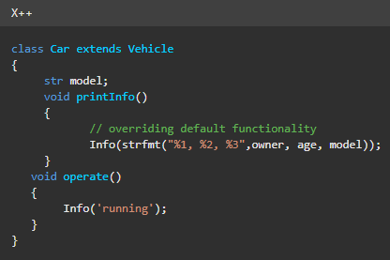
4. Develop object-oriented code in finance and operations apps
4.1 Introduction
OOP is the foundation of X++, the programming language used for finance and operations apps development.
4.2 Explore inheritance and abstract classes
Inheritance and abstract classes are two important programming constructs that are found in object-oriented programming languages.
Inheritance
Abstract

Slide 29
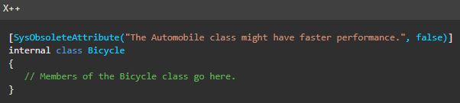
4.3 Use attributes
Attributes represent or store metadata about the behaviors of classes and methods. An attribute can be attached by simply typing the name of the attribute that is enclosed in square brackets before the declaration of class/function where it needs to be applied.
Attribute classes
Attributes have many uses, including the following:
attribute in Web services to indicate if the method should be callable over the Simple Object Access Protocol (SOAP) to exchange information.
Using DLLImportAttribute to call unmanaged code.
Describing the title, version, description, or trademark of an assembly.
Describing how to map between classes, members, and eXtensible Markup Language (XML) nodes for serialization.
Describing the security requirements for methods.
Specifying characteristics to enforce security.
Getting information about the caller to a method.

Slide 30
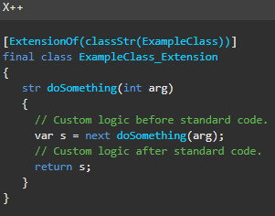
4.4 Implement Chain of Command
CoC allows you to extend the logic of public and protected methods without changing the base code.
The following code example shows how the class must be declared to use CoC. When the ExampleClass.doSomething() method is called, the code will first run all the code before the next keyword. Then, the original code in the ExampleClassdoSomething() method will run. Finally, all code after the next keyword will run.

Slide 31
4.5 Implement X++ scoping and access identifiers
Public - Methods that are declared as public can be called from anywhere that the class is accessible. In addition, a public method can be overridden by a subclass unless the method is declared as final.
Protected - Methods that are protected can be overridden in subclasses. Methods that are declared as protected can be called only from:
Methods in the class.
Methods in a subclass of the class that contains the protected method.
Private - Methods that are declared as private can be called only from methods in the class where the private method is declared. No private method can be overridden in a subclass. When you create a new method, the default accessor keyword that appears in the code editor is private. Private is the most conservative default for maximum security.
Internal
When you select a class or method as internal, it can only be accessed from within the model where it's defined.
Instance variables
Instance variables have a large scope and are also referred to as class fields in X++
Local variables
Local variables have a small scope. These variables are defined in a method and can only be accessed in that method.

Slide 32
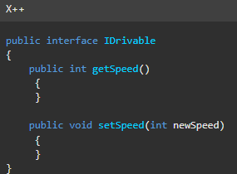
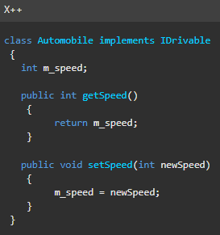
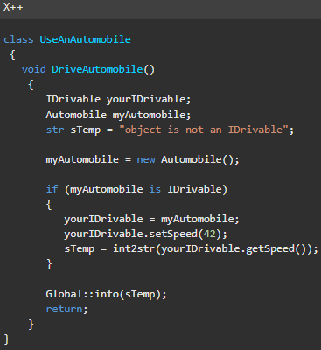
4.6 Interfaces
An interface is a specification for a set of public instance methods. An interface defines and enforces similarities between unrelated classes without having to derive one class from the other.
To create an interface, follow these steps:
In Solution Explorer, right-click the project, and then select Add.
In the New Item dialog box, select Interface and then enter a name for the interface.
Select Add.
Click the link: Exercise - Create an extension by using Chain of Command

Slide 33
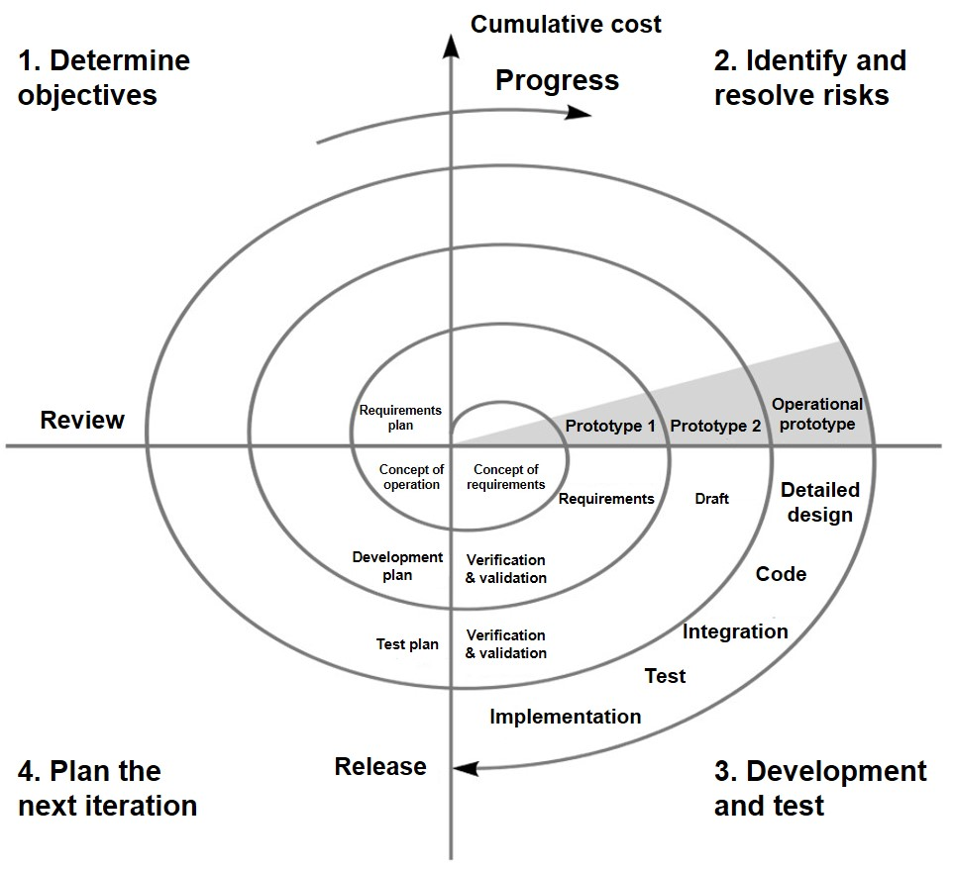
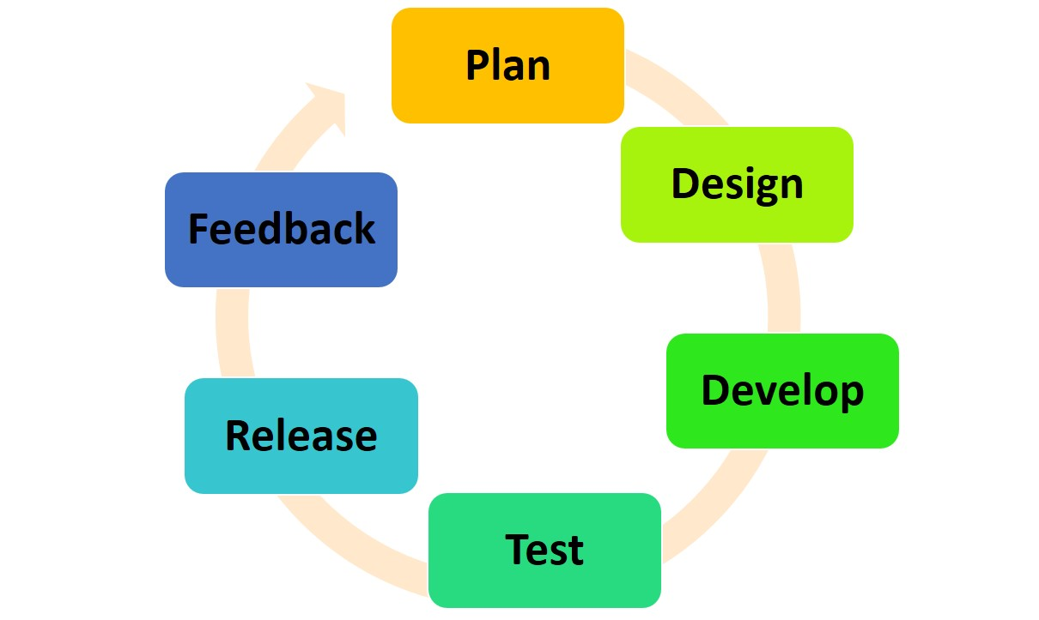
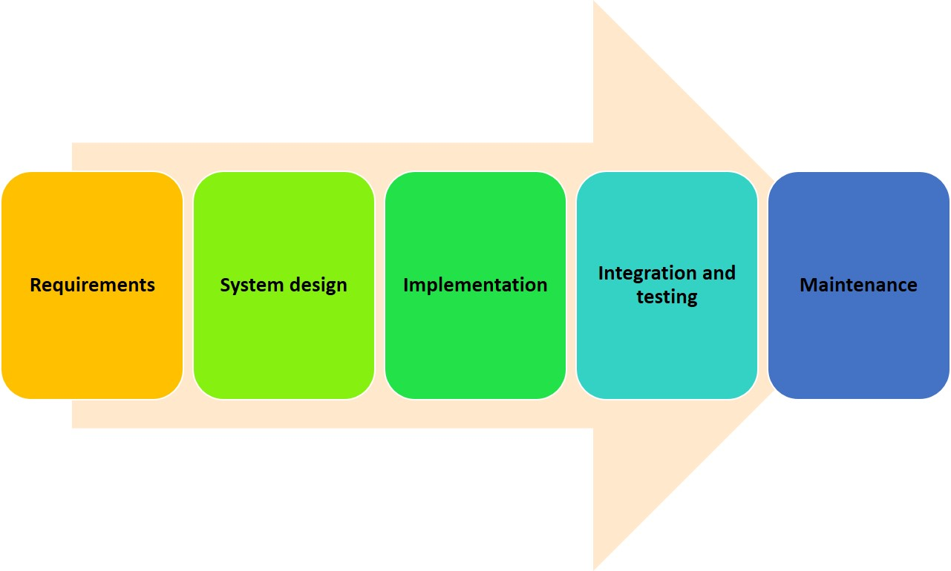
5.Implement application lifecycle management in finance and operations apps
5.1 ALM methodologies
Application lifecycle management (ALM) has a broad perspective that continues until the application is no longer used.
Waterfall methodology
Agile methodology
Spiral methodology

Slide 34
5.2 Design and create models
This unit reviews how to identify, apply, and manipulate a model, as well as providing an overview of models and their importance in development.
Importance of models
In finance and operations apps, models are mandatory for customizations. Models can be thought of as a collection of Microsoft Visual Studio projects.
Create a model
In Visual Studio, you can use the Create model wizard under the Dynamics 365 button to create two types of models:
A model that is deployed in its own package
A model that is part of an existing package
You can also update model parameters in Visual Studio from the Dynamics 365 menu.
To do this, select Model Management and then select Update model parameters. Then, select the model name to update the parameters and dependencies of the model.

Slide 35
5.3 Plan the build, test, and quality control processes
This unit reviews development processes that are used to manage the build, testing, and quality control processes, and provides information about how to plan for managing these processes.
Create a project plan for builds
Decide what environments are needed
A Tier-1 environment is a single-box environment with all the components installed on the same server.
A Tier-2, or higher, environment is a multi-box environment with components that are installed on multiple servers.
Plan for how much testing is required
Testing should be comprehensive and cover unit, regression, and performance tests.
Source control and quality control for developers
Source control can be used to track changes to code and prevent developers from interfering with each other's work.
5.4 Identify upgrade scenarios and appropriate tools
Upgrades, updates, and hotfixes can include moving to new product versions, code migration and upgrade, moving to an update, or deploying a hotfix.
Apply updates to an on-premises version of finance and operations apps.
Apply updates to the cloud version of finance and operations apps.

Slide 36
5.5 Plan the release, change, and risk management processes
Microsoft releases regular updates to finance and operations apps. These releases come in Platform and Application releases. They can include updates to new functionality, bug fixes, or general system performance improvements.
Releases are classified as upgrades and updates.
Identify risk
Upgrades and updates to the system can bring a lot of change. It is important to identify risk groups to identify specific risks to a company.
Applying some risk management skills might help reduce these risks:
Identify any potential threats.
Assess what areas are vulnerable to those threats.
Determine the likelihood, or risk, of areas that are being affected.
Identify ways to reduce the risk.
Prioritize the risk reduction plans.

Slide 37
6.Build extended data types and enumerations for finance and operations apps
6.1 Introduction
In this module, you will learn when to use base enums and EDTs and about the benefits of using each type.
6.2 Extended data types and element properties
In the AOT, you can create EDTs and base enums that build on the primitive data types.
Booleans - Dates -.Enums -GUIDs -.Integers - Real String -TimeofDay -.UTCDateTime
Benefits of using EDTs
Code is easier to read when you are using EDTs
The properties that you set for an EDT are used by all instances of that type
You can create hierarchies of EDTs
Most fields in the tables of finance and operations apps are based on EDTs
EDTs have various behaviors that you can use in your development

Slide 38
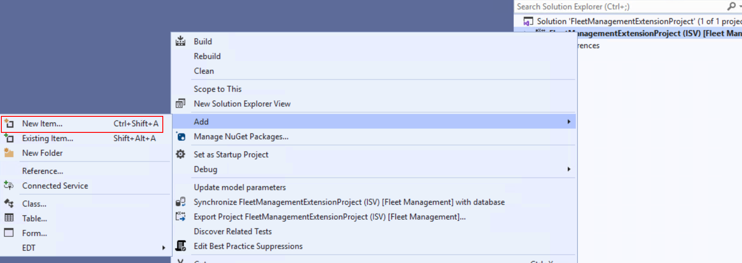
6.3 Base enums and element properties
Enum values are represented internally as integers, and they are stored in the database as a number instead of the value, which is useful because it saves space.
The first literal has the number 0, the next has the number 1, and so on.
Enum No Yes has two associated literals, where No has the value 0, and Yes has the value 1.
Base enum can also appear as a drop-down menu in the user interface.
Elements that are added to a base enum are stored in the database as a numeric value.
Click for Practice : Lab - Create a base enumeration, add elements, and update properties

Slide 39
7.Build tables in finance and operations apps
7.1 Create tables and table fields
Tables are the building blocks of Finance and Operations apps, storing data and metadata that is used to create forms and reports.
Tables are made up of fields, which are organized into field groups
An index can be created from fields within a table, and aids in data retrieval.
Customer table information is shared with another table, you must create relation between 2 tables.
Tables are added to a project through the Solution Explorer window.

Slide 40
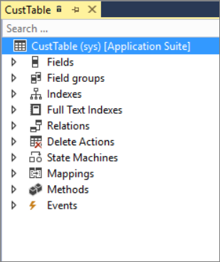
Table designer Components
Fields - Make up the data in the table and can be base enumerations or extended data types.
Field groups - are logical groupings of physical database fields that can be used on forms and reports to improve usability and maintainability.
Indexes - Are a method for speeding up retrieval of data from a table.
Relations - Define how a table relates to records in other tables.
Delete actions specify what should happen when data in a related table is deleted.
State machines- Enable you to perform state transitions within the workflow without writing any additional code. These are primarily used with workflows.
Mappings - With a map, you can associate a map field with a field in one or more tables. This enables you to use the same field name to access fields with different names in different tables.
Methods - Methods are pieces of code that are added to a table that can be run when certain events or changes in the data occur.
Events - Are also pieces of code that are raised as preceding and succeeding operations around base methods.

Slide 41
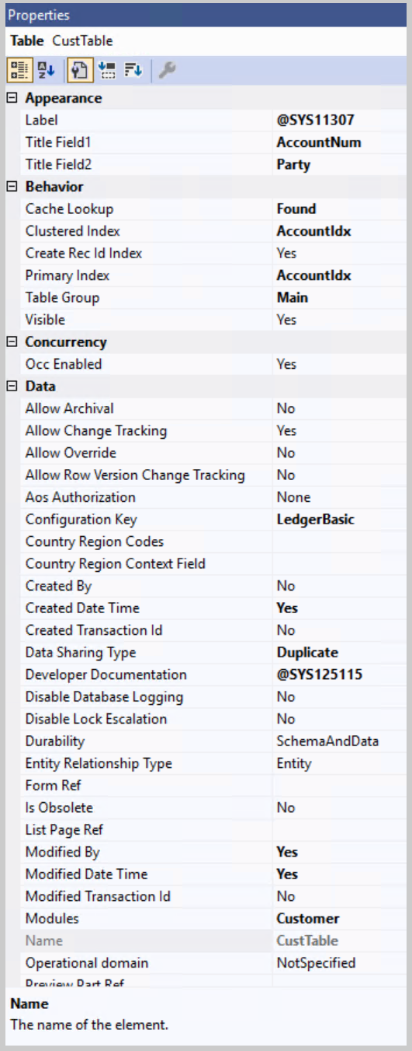
7.2 Populate table and field properties
When a new element, such as a table or field, is added to a project, we recommend that you update and modify the element's properties.
Table Properties that can be manipulated :
Table type - Determines if the table is considered a regular database table or a temporary table, such as a TempDB or InMemory table.
Name - Names and labels should use camel case, but table names should be all caps.
Label - Will be added from a label file and is used to identify the table in Visual Studio.
Primary index - Specifies which field in the table should be used as the primary index and is used for database optimization purposes.
Cluster index - Specifies the field by which the table should be organized. This property should never be left blank.
Configuration key - Allows a system administrator to enable and disable certain parts of the application and ensures that a table is removed when the key is disabled.
Support inheritance - The CanBeBaseTable property determines whether a table can be extended by inheritance.
Extends - Used when the Support Inheritance property is set to Yes. The Extends property chooses the base table that will become the parent table to the current table.

Slide 42
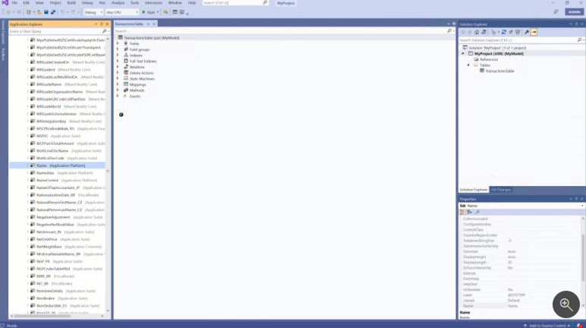
7.3 Add fields, field groups, indexes, and relations
Create fields and add them to a table, then create field groups to pool associated fields.
Field groups improve consistency in form design and reduce the need for manual changes to forms.
The following animation shows a field being selected and dragged from the Application Explorer window to the Fields node of a new table in the Table designer window.
Indices are created on a table to improve efficiency with data retrieval.
When you are determining which fields to use for the index, consider fields that are often searched by a range or query.
For efficiency, an index should be organized from the most granular column (highest number of unique values) to the least granular column.

Slide 43
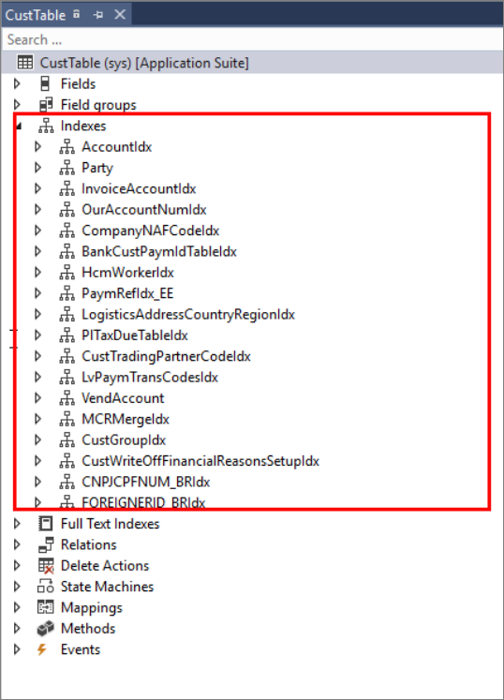
The three types of indices that are used in finance and operations apps are:
Primary index - A primary index is a unique key that cannot have duplicate values.
Clustered - A clustered index is an index that physically orders the data in a table.
Non-clustered - A non-clustered index provides a way to quickly find data in a table by using a specified set of columns.
Relation types are defined as follows:
Normal relation - Specifies relation fields without conditions.
Field fixed relation - Specifies relation fields to restrict the records in the primary table.
Related field fixed relation - Specifies relation fields that restrict the records in the related table.
Foreign key relation - Specifies a correspondence between a foreign key field in the present table and the primary key field in another parent table.

Slide 44
7.4 Table methods
Each table has methods, which can be classified as standard methods or custom methods. Standard tables must have a super() call to run the framework logic.
Table methods can be extended using the chain of command option or by creating table delegates.
initValue() : You can use this method to address the requirement of initializing some field values while a new record is being created.
find() : This method returns a specific record based on primary key or other unique keys. This method is a static method.
insert() : To populate data in a field based on the value of some other field in the table.
modifiedField() : To populate data into a field while some other field is modified in the same record.
validateField() : You can use this method to perform data validation while data is being entered into the field.
validateWrite(): The OnValidate method is called when a user attempts to save or navigate away from a record and can be used to validate data.
Extension of table methods : Chain of command is an option that helps you enhance the functionality of a table method. This option is applicable for standard methods and custom methods.
Click to Practice: Lab - Create a table, add fields, and create field groups

Slide 45
8. Build forms and optimize form performance in finance and operations apps
8.1 Introduction
Forms are created and managed in Visual Studio and will display to the user as web pages in finance and operations apps. The user interface is optimized for multiple platforms and mobile apps and is an easy-to-use experience.
8.2 Add a new form to a project and apply a pattern
Form patterns are a best practice for structuring and developing forms.
Form patterns provide a guided experience to ensure that forms are correct, consistent, and responsive.
Types of Form Patterns :
Simple List pattern - To maintain data for entities that contain six or fewer fields and no parent/child relationships.
Simple List and Details pattern - Used to maintain data for entities that contain six or more fields.
Simple Details pattern - Used to present a simple set of fields to the user; generally, it is in view mode instead of in edit mode.
Master Details pattern - For entering data. Users can view and edit data that is organized into expandable and collapsible FastTabs.
Details Transaction pattern - To present data details in a Header view and a Line view.
List Page pattern - To present data in a manner that is optimized for browsing records and allows the user to act on a specific record.
Table of Contents pattern - when at least two forms are required for setup configuration.
Workspace pattern - To create a finance and operations apps workspace, which is a grouping of tasks and specific pages.
Wizard pattern - Tto guide a user through a specific task by using an ordered series of tab pages.

Slide 46
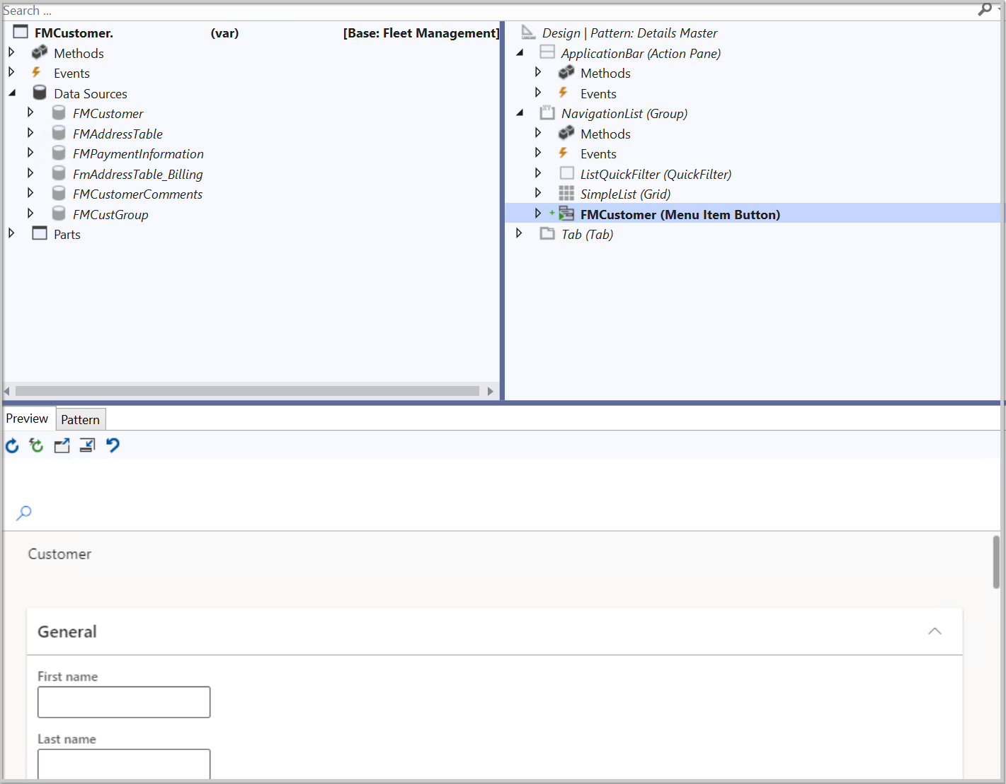
In Visual Studio, a form is added to a project in the Solution Explorer window. The form designer window looks different from other element designers because of the additional panes.
The form designer has 3 panes:
left pane for methods, events, and data sources.
right pane for applying patterns and sub patterns.
bottom pane for pattern design and preview.

Slide 47
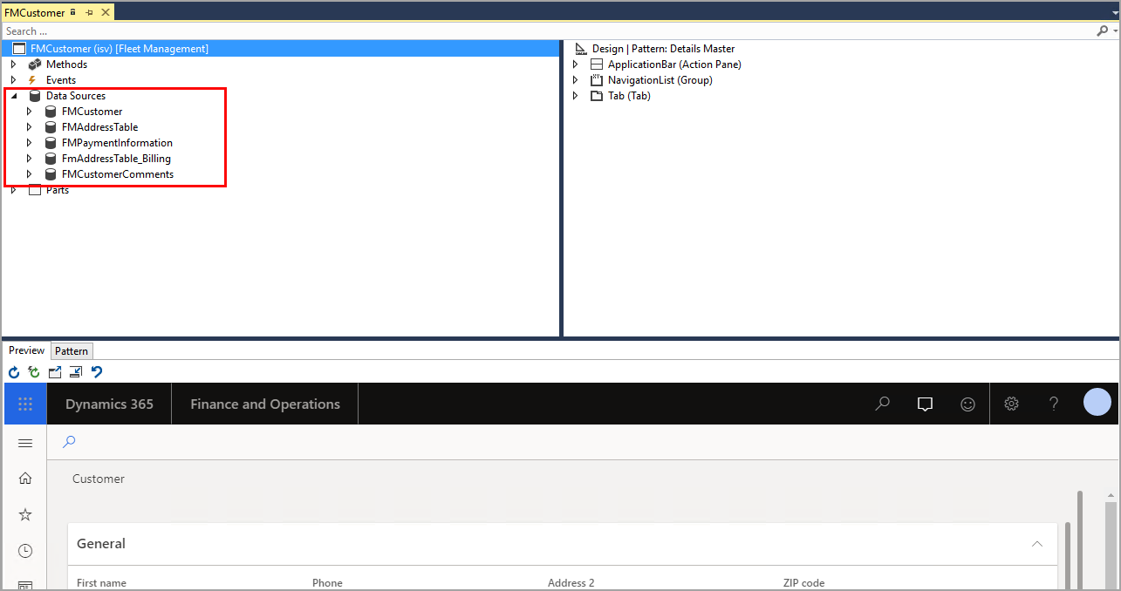
8.3 Add a data source to a form
A data source must be added to a form in the form designer window of Visual Studio. You can select and drag a table or query from your project in the Solution Explorer window or drag a system table from the Application Explorer window.
Follow these steps to add a data source :
In the Application Explorer window, expand the AOT node. You can view the Application Explorer window by going to View > Application Explorer.
Expand the Data Model node.
Expand the Tables or Table Extensions node, depending on the type of data source that you are adding.
Select and drag your desired table from the AOT node to the Data Sources node in the left pane of the form designer window.

Slide 48
8.4 Add grids, fields, and groups to a form
When a table is listed under the Data Sources node on the left pane of the Form designer window, it can then be used to add fields to the Grid node of the pattern design.
Follow these steps to add more controls to your form:
In Visual Studio, ensure that you have applied your desired form pattern by right-clicking the Design node on the right pane and selecting Apply pattern.
After adding a data source by following the steps in the previous unit, you will now begin adding controls to the form by following the steps in the correct order on the Pattern tab on the bottom pane of the form designer window. For example, in a Simple List form pattern, you need to add an Action Pane, then a Group, and lastly, a Grid.
Right-click the Design node on the right pane of the form designer and select New > Action Pane.
Right-click the Design node and select New > Group. Notice that the Group control requires a pattern. Based on the form type, you will choose a desired subpattern.
Right-click the Design node and select New > Grid.
From the left pane, expand the Data Sources node and then expand your table.
Expand the Fields node of your table.
Select the fields that you want displayed in the grid on your form, in the order that you want them displayed in the form. You can select multiple fields by using the Ctrl key.
Drag the selected fields from the Fields node on the left pane to the Grid node on the right pane.

Slide 49
8.5 Form methods
init(): Its called when a form is opened, method is responsible for creating the runtime interface of the form.
close(): It is called when a form is closed, method to facilitate an abort operation.
closeCancel(): It is called when a form is canceled, ensures that the modifications in the form aren't saved.
closeOK(): It is called when a form is closed by selecting the OK button.
run(): It is called immediately after the init() method.
Typical reasons for overriding this method include:
Activating or deactivating some fields.
Modifying the query.
Standard form data source methods:
init(): It which is called when a form is opened after the implementation of the form init() method.
active(): It is called when a user navigates to a new record.

Slide 50
8.5 Form methods cont..
validateWrite(): it is called when a user attempts to save a record to determine whether data is valid and ready to be written.
validateDelete(): it is called when a user attempts to delete a record, to confirm the deletion.
executeQuery(): It runs the data source query and displays the retrieved records.
initValue(): While you're inserting a new record, method is a standard method of a form data source. While you're inserting a new record, initValue() can help you initialize field values.
write(): This method is called when a record is modified and when you've attempted to save it by selecting the Save button or navigating out of the record.
delete(): This method is called when a record is deleted.
Standard form data source field methods
modified(): This method is called when the value of a specific field is modified.
validate(): This method is called when a value is entered in a specific field, and it's overridden if extra field validation is needed.
lookup(): This method is called when a lookup operation is attempted on a data source field, for customized data to be showed in lookup we have to override the method.

Slide 51
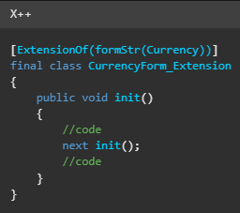
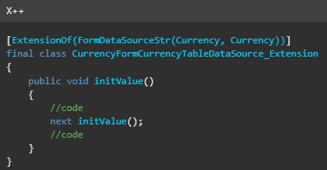
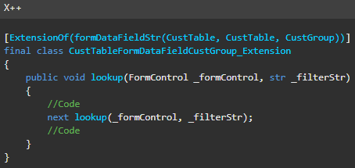
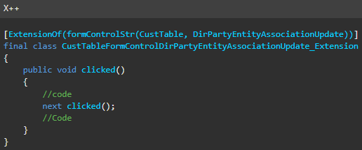
Form Extensions Methods
Extension of a form method
Chain of command is an option that helps you enhance the functionality of a form method.
Extension of a form data source method
Chain of command is an option that helps you enhance the functionality of a form data source method.
Extension of a form data source field method
helps you enhance the functionality of a form data source field method
Extension of a form control method
helps you enhance the functionality of a form control method.

Slide 52
8.6 Create and populate menu items
Menu items are used in the finance and operations apps user interface to present the user with a button that will link to a page, dialog box, report, or perform a task.
3 types of menu items:
Display menu item - For runnable application objects that primarily present forms and dialogs to the user.
Output menu item - For runnable application objects whose primary function is to print a result, such as a report.
Action menu item - For runnable application objects whose primary function is to do a job, such as creating or updating transactions in the database.

Slide 53
8.7 Test form functionality and data connections
When the requirements for a form pattern have been completed, and before a form goes into production, you should test its functionality in Visual Studio.
Watch the following video to see the process for setting a form as a startup object and previewing it in a web browser.
8.8 Diagnose and optimize client performance
You can optimize form performance by using browser-based tools and previewing the form in a browser.
You can open the Developer tools win.dow by selecting Ctrl+Shift+i. On the Performance tab, you can record your scenario.
Diagnose and optimize client performance by using Performance timer
Performance timer is a tool that aids in diagnosing performance issues on the client and server.
Performance timer is generated by opening a web page with the added parameter =
debug=develop: https://<yoursite>.cloud.test.dynamics.com/en/?cmp=USMF&debug=develop
The Performance timer will appear in the top-right corner of finance and operations where you can see the separations between client time and server time.

Slide 54
8.9 Optimize form loading and performance
When navigating in finance and operations apps, users want pages to load quickly and performance to be high.
You can do this by setting the form as a startup object in the Solution Explorer and starting it with or without the debugger.
In code that is on a form, you can use info() statements to log status messages that you can view through the Infolog window.
Click to Practice: Lab - Create a form

Slide 55
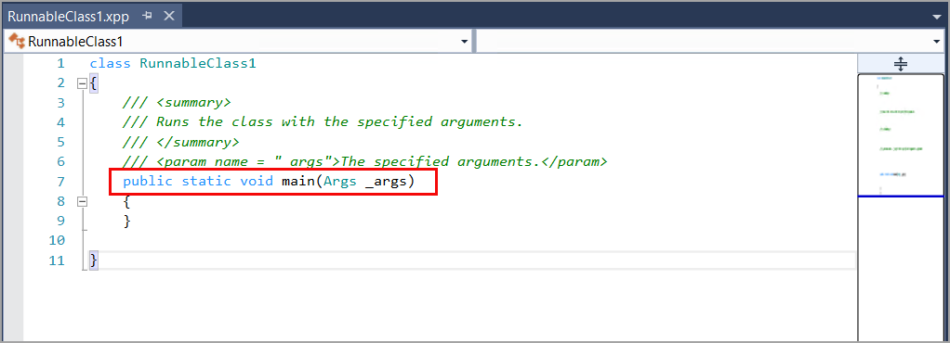
9. Create classes in finance and operations apps
Classes are blocks of code that contain data and methods. When developing for finance and operations apps, you will use the X++ language to create new classes.
9.1 Introduction
Some elements in the Application Object Tree (AOT), such as tables and forms, contain classes out of the box. Many types of methods and statements can be called to dictate the behavior of objects.
Classes can be added to a project to declare new elements, variables, or methods.
A runnable class for finance and operations apps, known previously as a job, is similar to a standard class, except that it contains a main method.

Slide 56
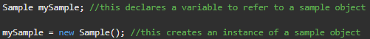
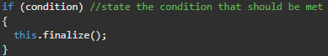
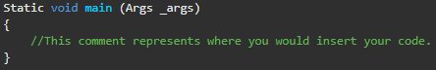
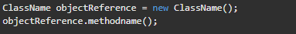
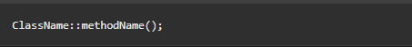
9.2 Add code and methods to meet business requirements
After you create a class from Solution Explorer, you can add code to the class. Data provides the state of an object, while a method provides behavior to an object
New method - Creates an instance of the class by using the new keyword.
Finalize method - A destructor method that finalizes an instance of a class by using the finalize keyword.
Main method - Creates an instance of an object and calls the required member methods.
Instance method - Is referred to as an object method, it is embedded in each object that is created from the class that contains the instance method and must be instantiated before using.
Static method - With a static method, unlike with an instance method, you don't need to instantiate an object before you use the method, used to work with data that is stored in tables.

Slide 57
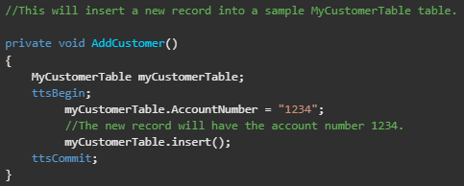
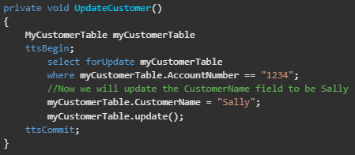
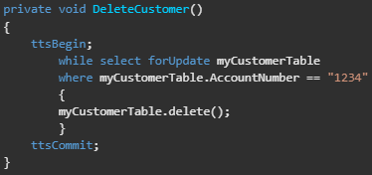
9.3 Data manipulation
Use [select, insert, update, where, from, delete] with code to manipulate data stored in database.
For example, the following code sample will fetch all columns in the first row of the CustTable, then it will print the value in the AccountNum column of that row:
Insert method:
Update method:
Delete method:
Click to Practice: Lab - Insert records by using a runnable class

Slide 58
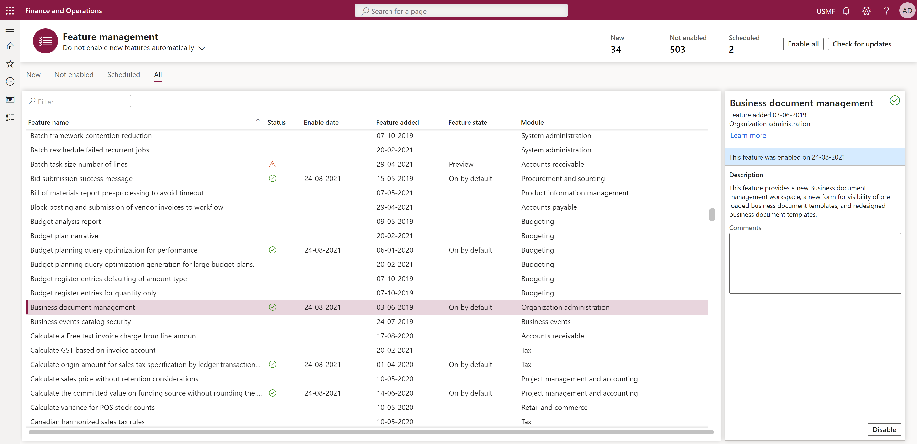
10.Build reports for finance and operations apps
Reports can organize data in a meaningful way. finance and operations apps include reporting tools to help you create reports for your organizations.
10.1 Implement Business document management
Business document management in finance and operations apps allows you to set up business documents, such as invoices within the web client.
Business document management allows users to create and modify output documents, without relying on SQL Server Reporting Services (SSRS) report development.
You can enable the Business document management feature from the Feature management workspace.

Slide 59
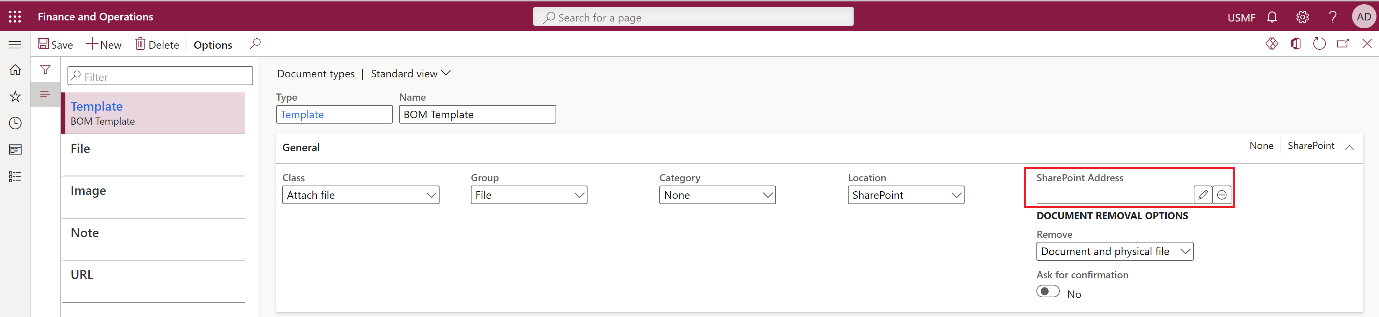

Set up parameters
Use the Template document type to specify a temporary storage of documents in Office formats (Excel and Word) that are used as templates for Electronic reporting reports. Then, make sure that you provide the SharePoint address for the temporary storage. Can edit this template Office desktop app.
Use Business document management to edit a template

Slide 60


For the initial setup, you can import the template from Microsoft Dynamics Lifecycle Services, such as Electronic reporting. Additionally, you can create a new template by selecting Create template.
You can edit a business document from the Business document management workspace when it's set up with Electronic reporting. You can edit Excel and Word files directly from the workspace.
Set up access permissions :
Users who are assigned to the System administrator role.
Users who are assigned to any other role that is set up to perform the duty Configure permissions to access Business document templates for editing.

Slide 61
10.2 Create and modify reports that use SSRS
SSRS reports allow you to print reports to different locations, such as your screen, a printer, a file, or an email.
You can schedule your reports to run periodically by using a batch job. SSRS reports can also help you create precise compliance documents for your local regulatory business.
Design SSRS reports
Determine the data needed, choose the report design, and create the report.
Create SSRS reports
The four data source types in SSRS reports needed are:
Query - Uses an existing Application Object Tree (AOT) query. Using an existing query allows for faster filtering of data in SQL to quickly generate reports and requires limited X++ code to develop.
Business logic - Is used to get a data source other than finance and operations. The Business Logic data source type can only be used with a single report because the name of the class must match the name of the report.
Report data provider (RDP) - Is used when a query cannot be used alone; additional logic is needed to run the report.
AX enum provider - Can be used to filter the report view when the report parameter is an enum type.
Modify SSRS reports
You can modify existing reports without affecting the standard report solutions by using extensions.

Slide 62
10.3 Implement query objects and query builder
You can use these queries to render data into forms, reports, views, and more. Additionally, you can write SQL statements by using select queries. The query object helps you create the SQL dynamically at runtime.
QueryBuildDataSource class
The QueryBuildDataSource class is the building block for creating the query. It defines the data source to be added to the query. It can specify the table fields to be added, sort order of the records, and so on.
QueryBuildRange class
The QueryBuildRange class defines filtering for the records that are fetched from the data source.
Advanced query syntax
A range of advanced query syntax exists for string, number, or date fields. For string fields, you can filter by equal, not equal, range, wildcard, and so on.
Build a query that includes a relational table
By using a query object, you can build a query that includes related tables. You can define all types of joins as required by your query.

Slide 63
10.4 Create and modify reports by using Power BI
Power BI is a tool that promotes data exploration. By using Power BI tools, you can interactively explore data to truly understand it. You can pivot columns, change the shape of charts, filter data, and share reports.
Create a Power BI report with finance and operations apps data
Connect to the data, create visualizations, and push the report to production.
Watch the following video to learn how to connect to your data in finance and operations by using Power BI:
Modify a Power BI report
Unlike SSRS reports, which require multiple reports to see different views of the same data, Power BI can be used for quick and simple manipulation of how your data is viewed. You can adjust existing reports to filter data as you need it.

Slide 64
10.5 Create and modify reports by using Excel
Download the Microsoft Dynamics Add-in.
On certain pages, select the Open in Office icon on the Action Pane and choose Open in Excel or Export to Excel.
Optimize data source queries
SSRS: Only pull the data that you need from the query. Avoid unnecessary joins or additional fields.
Power BI: Remove unused fields, avoid unique fields with high cardinality, and avoid excessive slicers on data.
Ensure correct use of display fields
Grouping organizes data into meaningful layouts by creating headers and footers or tables.
Expressions are functions that can be used to retrieve, calculate, format, and display data.
Labels allow text to be automatically translated to multiple languages.
Properties control the font, style, and margins of text and fields.
Exercise - Create and deploy a report

Slide 65
11.Build workspaces in finance and operations apps
Workspaces are personalized work centers with data, reports, and transactions.
Developer environment is used to create and modify workspaces that include advanced features.
Learning objectives
In this module, you will:
Design and build key performance indicators (KPIs).
Create workspace elements.
Use Report Definition Language (RDL) to create custom reports.
Implement reporting components into workspaces.

Slide 66


11.1 Design KPIs
KPIs can be embedded in workspaces to provide users with key measurable values.
KPIs are metrics that measure performance against objectives.
Default aggregate property defines the type of aggregate measurement to be used. By default, it uses the count measure.
Usage property defines how the aggregate measurement is deployed. It can be deployed to InMemoryRealTime or StagedEntityStore.
InMemoryRealTime uses Column store indexes of the SQL Server database to get real-time data.
StagedEntityStore uses the Entity store that uses near real-time Power BI reporting.

Slide 67
Create a new project in Visual studio
Open Visual Studio as an Administrator and under Get started, select Create a new project.
In the search box, type Finance Operation and select the template for finance and operations project and select Next.
Name your Project NewKPI and select Create at the bottom of the page. This will create your NewKPI project.
Create aggregate measurements
In the Solution explorer, right-click your project and select Add New > New item.
Under Dynamics 365 Items select Analytics > Aggregate Measurement.
Open Application Explorer by going to View > Application Explorer if it does not already show up on your page.
Go to Data Model > Views and select the FMVehicleExtendedView view to create measurements. Because the project model is Fleet Management the FMVehicleExtendedView view is compatible.
Drag and drop the FMVehicleExtendedView view in the MeasureGroup1 group for the Aggregate measure.
In the Dimensions group, right click on Date and select Delete.
Read more..

Slide 68
Create model dimension references
To create model dimension references, follow these steps:
From the Solution Explorer, drag and drop the Aggregate dimension into the Aggregate measurement's Dimension node in the middle of the page.
Right-click the Dimension node and select New Dimension and rename the new dimension.
Select the newly created dimension, and then right-click and select New relation.
Name the new relation and change the Dimension attribute to Model.
In the child node, set the Related field property to Model.
Save all and Build.
Create a KPI
To create a KPI, follow these steps:
Right-click the project and select Add > New Item.
Under Dynamics 365 items select Analytics > Key Performance Indicator.
Select Add.
Set the Measurement property to select the measurement for the KPI in the Properties section.
Select the Value node of the KPI.
Set the measurement group on the Measure group property.
Set the measure on the Measure property.
Select the Goal node of the KPI.
Set the Goal Type property to BasedOnMeasure.
Set the measurement group on the Measure group property.
Set the measure on the Measure property.
Select Save and Build.
Deploy aggregate measurements
To deploy aggregate measurements, follow these steps:
Select the aggregate measurement.
Set the Usage property in Properties:
InMemoryRealTime
StagedEntityStore
Right-click the aggregate measurement in the Solution Explorer, and select Add Column Store Indices.

Slide 69
Add the KPI to a workspace
To add the KPI to a workspace, follow these steps:
Right-click the project and select Add > New item.
Select User Interface > Tile.
Select Add.
Drag and drop the KPI from Solution explorer onto the tile in the Tile designer.
Save.
Create an extension of an existing workspace form or create a new workspace form. Ensure the solution model matches the workspace form model, otherwise you cannot make an extension of that form. Create an extension by right-clicking on the form in the AOT.
In the Designer, add a Tile button. You may need to change the pattern of the form to custom to do this.
Set the Tile property drop-down option to the KPI tile that you created.
Save all and build the solution.
The workspace will show the new KPI that was created. Select the KPI tile to view details.

Slide 70

11.2 Create drill-through workspace elements
Drill-through elements allow users to view additional data within a workspace.
Tiles are buttons that can display data or provide drill-through access.
Both drill-through elements and tiles can be created through X++ development.

Slide 71
Add a tile button to your workspace in the user interface
To add a Tile button to your workspace in the user interface, follow these steps:
Right-click the dashboard below the header image and select Personalize.
Select the +Add a workspace button. A new workspace will be created, titled My Workspace 1.
Right-click My Workspace 1 and enter a new name for your workspace. Read more..
Add a tile button to an existing workspace in the developer environment
To add a Tile button to an existing workspace, follow these steps:
Create a new project in Visual Studio and make sure that the model that your project is in references "Fleet Management." Verify that the model that your project is in references "Fleet Management" by following these steps:
Select the Dynamics 365 menu.
Select Model management > Update model parameters.
Select the model that you are using in the Model name drop-down list.
Select Next.
Ensure that the Fleet Management model is selected in the References models screen.
With the new project open in the Solution Explorer, right-click the project and select Add > New item.
Read more

Slide 72

11.3 Create custom reusable report functions by using RDL
RDL is an XML representation of an SSRS report definition.
It can be used to define charts, graphs, calculations, text, images, and other report objects.
All SSRS reports generate a .rdl file.
11.4 Implement built-in KPIs, charts, and other reporting components
Workspaces can contain main elements, built-in KPIs, charts, and other components.
Presentation types for elements in a workspace are Tile, List, and Link.
Elements can be added to a workspace from the user interface by selecting the presentation type and configuring the element.
You should follow these high-level steps:
Create the KPI object.
Define KPI range, goals, and/or tends.
Create a tile for the KPI to display on.
Add the KPI to the tile.
Practice Link Below:
Exercise - Create a workspace and add a tile, list, link, and Power BI element

Slide 73
12.Implement role-based security in finance and operations apps
Finance and operations apps use role-based security to assign access to components in the system.
A user who is assigned to a security role has access to the set of privileges that is associated with that role.
Learning objectives
In this module, you will learn how to:
Create and modify roles, duties, privileges, and permissions.
Review the role-based security hierarchy.
Use and enforce permissions policies.
Define the extensible data security framework (XDS).
Apply security permissions.
Stay compliant with user licensing requirements

Slide 74



12.1 Introduction
Role-based security grants access to finance and operations apps based on security roles.
Users are assigned to security roles based on their job responsibilities.
Roles contain duties, privileges, and permissions that control access to system components.
Create and modify duties, privileges, and permissions
Enforce permissions policy
Create new roles, duties, and privileges

Slide 75

12.2 Extensible data security framework
The flow for an XDS policy is as follows:
Start with a query to define the filters or limits that should be placed on the primary table or tables.
Create a security policy that links to the query and primary table for which you want to restrict data access.
Define the context for the rule. This could be based on a string, which would require additional development, or based on a role or group of roles.
Define the list of constrained tables, which are related tables that store data from the primary tables for which you are attempting to restrict a subset of data.
12.3 Apply security permissions
Users are assigned to security roles in the System administration module in finance and operations apps by going to Security administration > Security > Security configuration.
Click the link below: Lab - Create a new security role and add duties

Slide 76
13.Apply basic performance optimization in finance and operations apps
By optimizing your development for performance, you can ensure that your work is useful and appreciated by users. As a finance and operations apps developer, you should understand how your designs can be properly optimized for performance.
Learning objectives
In this module, you will:
Discover what temporary tables are and when to use them.
Learn about what set-based statements and row-based operations are, and when to use each.
Understand and demonstrate different methods for optimizing custom queries.
Learn about the different caching methods that are possible and when each should be used.

Slide 77
13.1 Introduction
Optimizing performance ensures that apps run efficiently and avoid frustration, distraction, and lower productivity.
Developers should understand how their designs can be optimized for performance.
Users will appreciate apps that are designed for optimal performance.
13.2 Identify and apply caching mechanisms
Cached data is stored on your computer to improve performance but takes up space.
Finance and operations apps cache settings for a table, 2 types of Caches:
Set-based caching caches all the records in a table in memory, but should be avoided for large tables.
Single-record caching - Caches a single record at a time. Two conditions must be met to use single-record caching.
Single-record caching is used to cache records in memory for faster access.
The CacheLookup property specifies how records are cached. It can be set to NotInTTS, Found, or FoundAndEmpty.

Slide 78

13.3 Optimize temporary table usage
This unit explains temporary tables, the different types of temporary tables, and when they should be used.
Temporary tables allow you to efficiently create and clean up temporary data. The two types of temporary tables are:
InMemory
TempDB
The table type can be determined on the table's TableType property.
The capabilities of TempDB tables include the following:
Joining to regular tables.
Using foreign keys.
Being per company or global.
Having indexes.
Having methods but an inability to override the methods.
Instantiating from the client or server tier.
Being used as a query.
Having no requirements for a configuration key.
TempDB Limitations:
Inability to manage date-effective data.
They do not contain delete actions.
Record Level Security does not apply.
You cannot use them in views.

Slide 79

13.4 When to use set-based statements and row-based operations
Set-based statements update, insert, or delete multiple records in one call to the database.
Row-based statements update, insert, or delete one record in one call to the database.
Set-based statements are more efficient than row-based statements because they require fewer calls to the database.
Three examples of set-based statements that can be used are:
Update_recordset - Used to update multiple records at once.
Delete_from - Used to delete multiple records at once.
Insert_recordset - Used to copy multiple records from one or more tables into another table.
13.5 Query optimization principles
Only pull the required data needed: This will reduce the amount of data that needs to be processed, which can improve performance.
Avoid nested queries: Nested queries can be slower than single queries, so it is best to avoid them if possible.
Lifecycle Services provides tools to help you monitor performance. To access these tools, go to the Cloud-hosted environments page and select the Full details link.

Slide 80

13.6 Modify the scope of a variable
Local variables are declared in a method and can only be accessed in the method that they are declared in.
Declaring variables at the smallest scope possible can help reduce overhead by only allocating memory during the time when the method is running.
This can improve memory efficiency by freeing up memory that is no longer needed.
13.7 Analyze and optimize concurrency
Finance and operations apps uses two concurrency models:
Pessimistic Concurrency Control (PCC) - Locks records as soon as they are retrieved from the database.
Optimistic Concurrency Control (OCC) - Locks records when they are being updated.
Advantages: OCC uses fewer resources and locks records for a shorter time, which can improve database performance.
Disadvantage: OCC can lead to update conflicts, which can reduce database performance if there are multiple retries to updates.
The concurrency model for a table can be overridden in a Select statement by using the optimisticLock or pessimisticLock keywords.

Slide 81
13.8 Apply parallel processing algorithms
Individual task modeling: Creates a separate batch task for each work item. This is best for small numbers of work items and for creating dependencies between work items.
Batch bundling: Uses a limited number of batch tasks that have a bundle size value. This works well for simple, even workloads with similar processing times.
Top picking: Creates a limited number of batch tasks where each batch task picks and processes the first free work item. This works well for uneven workloads with varying processing times.
13.9 Implement the Async framework
Asynchronous processing allows long-running processes to run in the background without interrupting the user experience.
To run a process asynchronously, you can use the runAsync methods from the FormRun and Global classes.
13.4 Develop Windows PowerShell scripts
Windows PowerShell is a task-based command-line shell and scripting language that can be used to automate tasks in finance and operations apps.
Developers can create PowerShell scripts to automate tasks such as database synchronization, service restart, and data mart reset.
PowerShell scripts can be used to deploy and install models and software deployable packages.
Click For Practice: Lab - Create runnable classes in Visual Studio to test code

Slide 82
Thank You
See you all next Saturday

